Slide 1
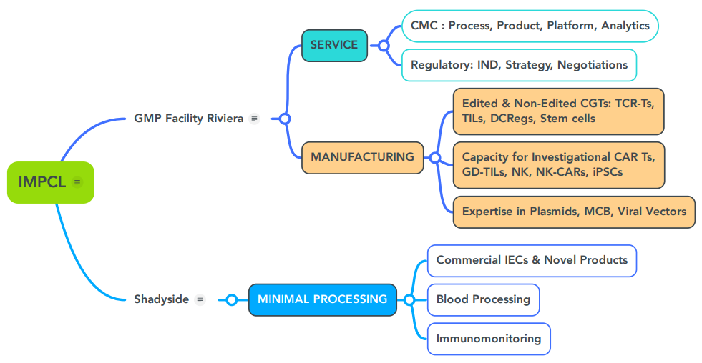
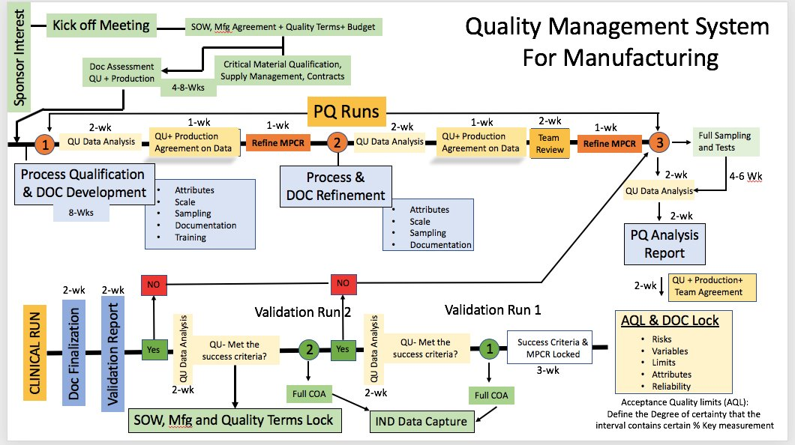
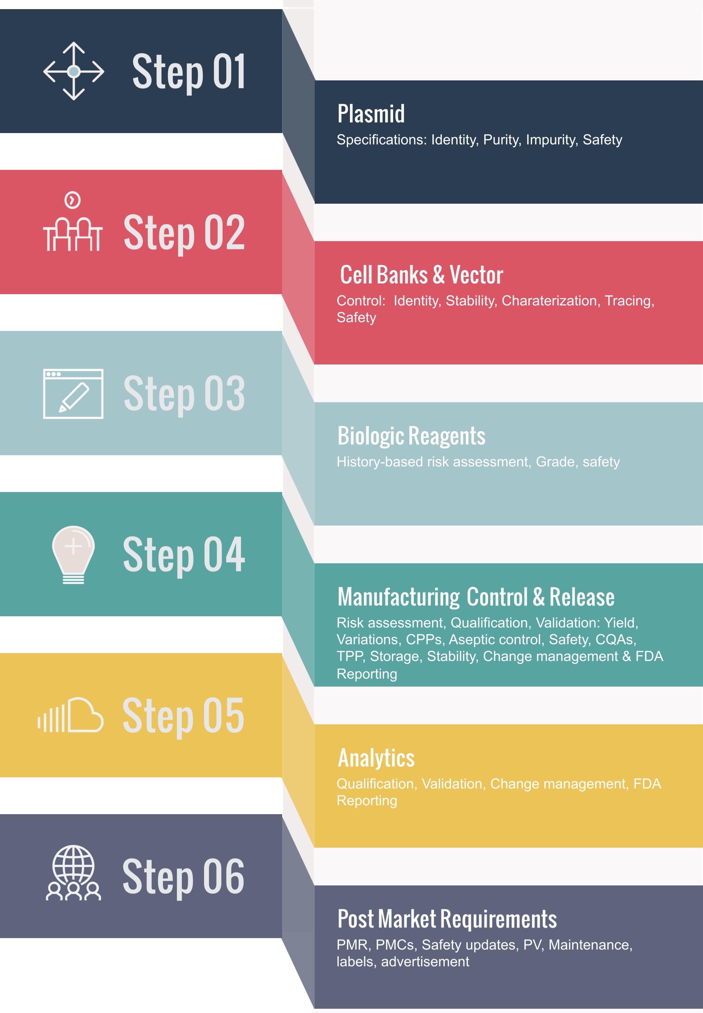
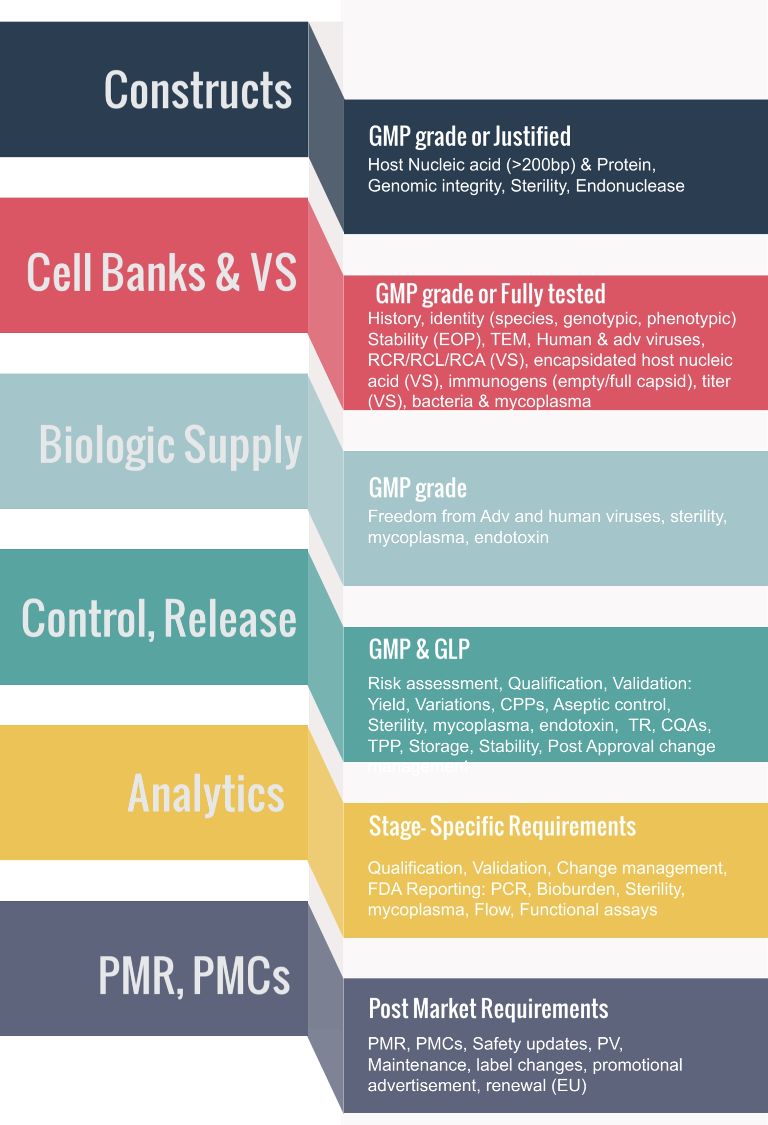
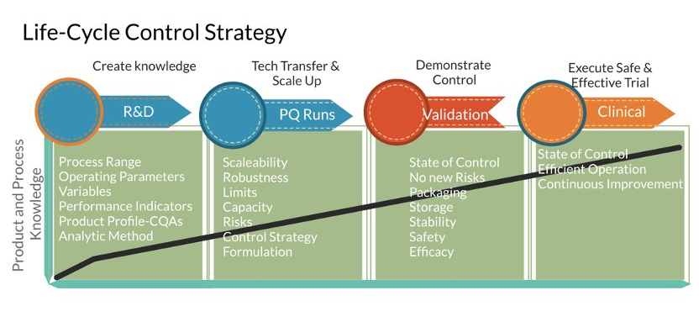
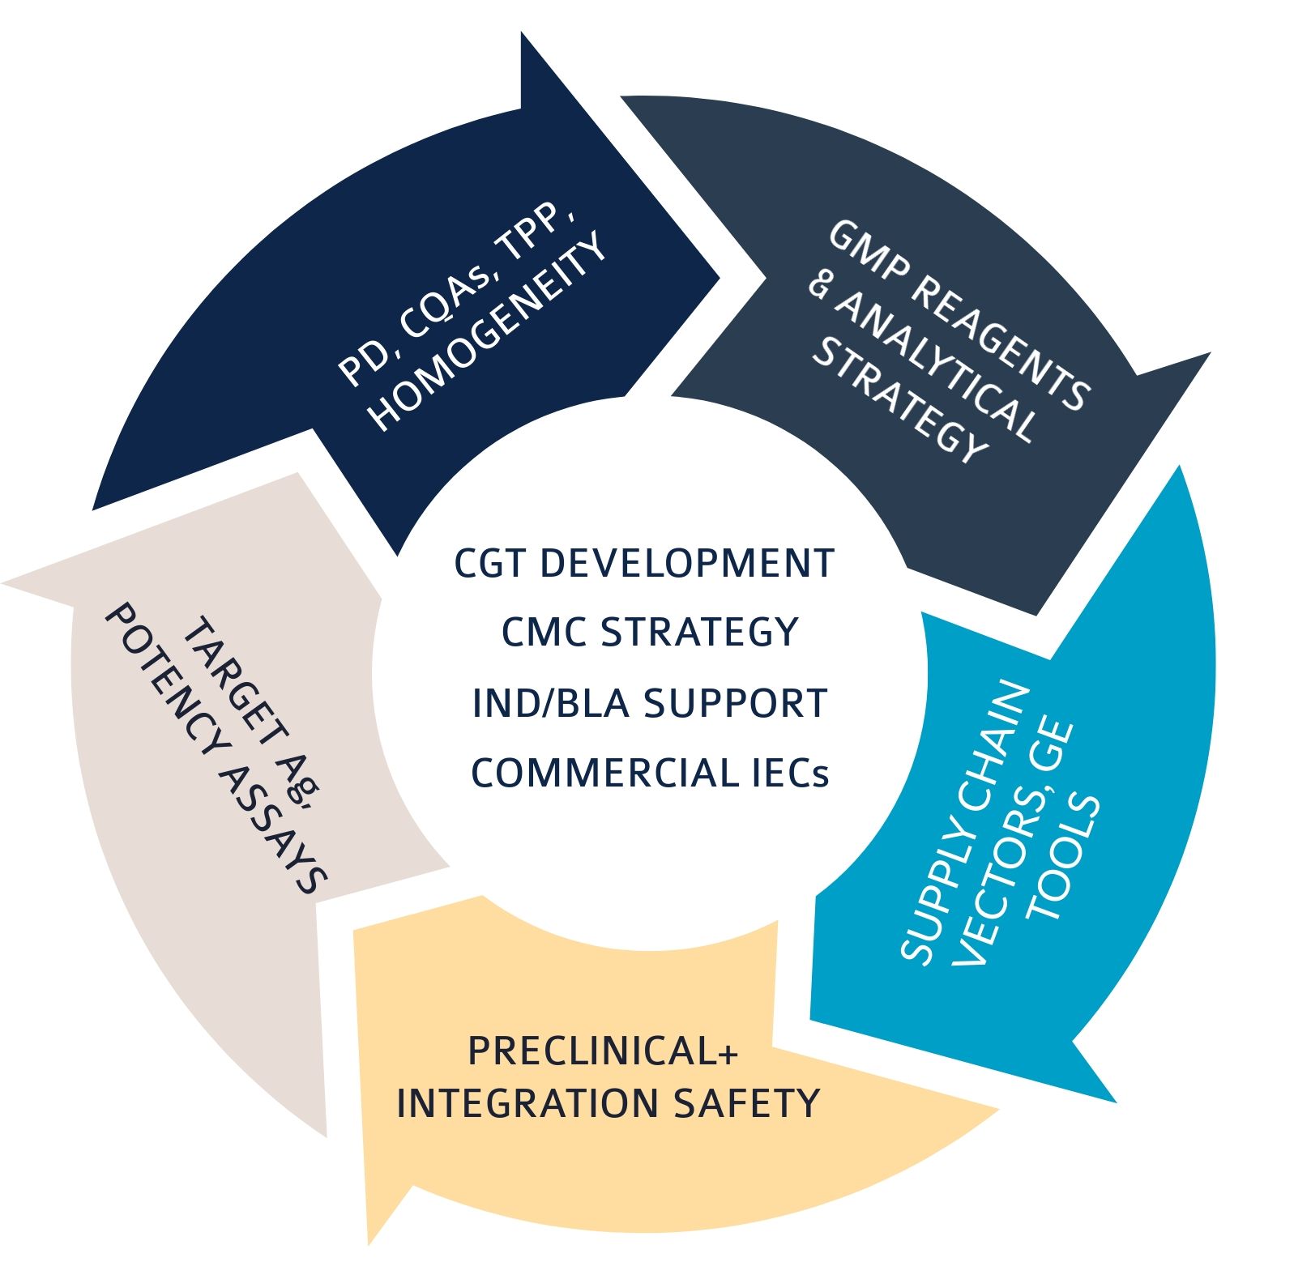
Immunologic Monitoring and Cellular Products Laboratory (IMCPL)​
The IMPCL Team
Services/Instrumentation
cGMP production of cell-based IND
Clinical scale cell processing
Biosafety testing (Sterility, Gram Stain, Mycoplasma, Endotoxin)
Virus Procurement (HIV, vaccinia)
Multi-parameter flow cytometry (14-color)
Cytokine/chemokine analysis (ELISA, Luminex)
Assay development
Blood processing
NC-200
CliniMacs
Terumo Elutra – GMP grade cell fractionator​
Miltenyi CliniMACS – GMP grade cell processing​
Fresenius Kabi LOVO closed cell processor​
Maxcyte GTx – GMP grade electroporator​
Controlled-rate freezer​
Bio-Rad Luminex​
BD LSRFortessa flow cytometer​
Multiskan microplate photometer​
Automated cell counter
FDA/PA DOH/CLIA registered/certified lab​
FACT/CAP accredited laboratory
OUR EXPERIENCE: YOUR PATHWAY TO IND
PRODUCT DEVELOPMENT STRATEGY & TIMELINE
Expand UPMC-wide access to FDA-approved cell​ therapy products
Novel CAR-T engineering and manufacturing​
Process, Product and platform optimization
Cell line, MCB and viral vectors
IMPCL RESOURCES FOR YOUR CMC STRATEGY
STAGE-SPECIFIC DEVELOPMENT GOALS
CONTROLS
Summary
Notes:
Text Font: Arial Narrow (Body)
Size: 32pt
Color: Black
Title Font: Century Gothic Bold CAPS;
Size: 88 pt
Color: R=120, G=28, B=98
Headers Font: Century Gothic Bold;
Size: 48pt, 32pt
Color: R=0, G=147, B=180
Lines: Style: Solid
Width: .5 pt
Color: Custom with Red=166, Green=166, Blue=166
Background: White

